Slide 1

Want to Host a
Florida State Convention?
Have a hotel in mind?
How to bid!

Slide 2
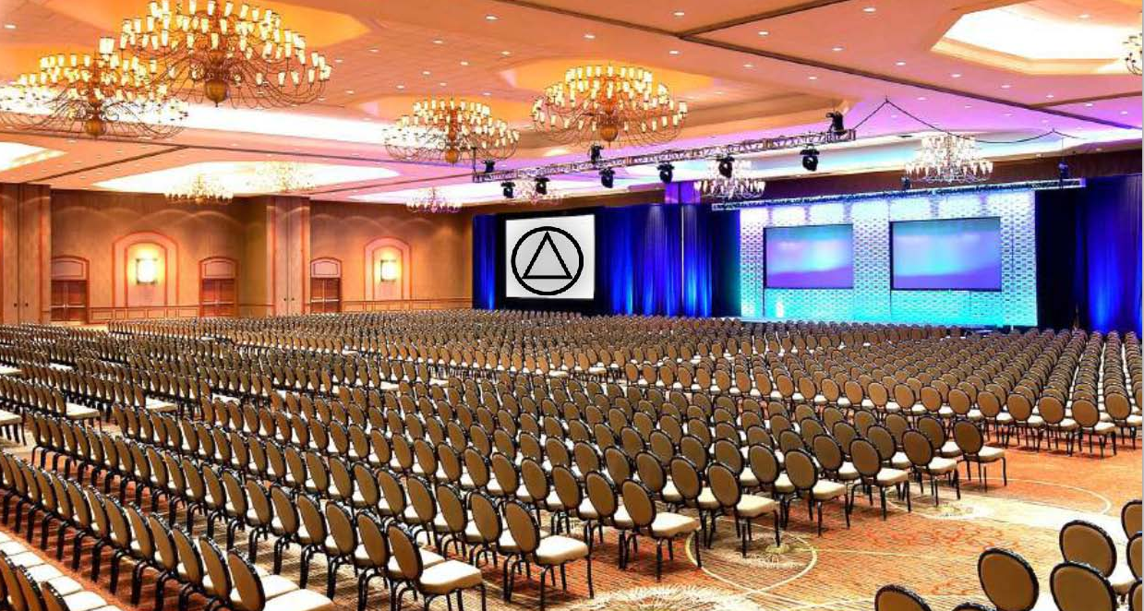

Slide 3
Upcoming Florida State Conventions
65th Florida State Convention
Aug 3 – 7, 2022 — Harbor Beach Marriott — Fort Lauderdale, FL
66th Florida State Convention
August 9 – 13, 2023 — Saddlebrook, Tampa, FL
Next? Yours?
67th Florida State Convention
July/August 2024 — North Florida

Slide 4
First Things First
Check out the Bid Packet
  Area 14 https://www.aanorthflorida.org/docs/BidPacket.pdf
  Area 14 https://area15aa.org/wp-content/uploads/2016/02/Bid-Summary-Revised.pdf
Start forming a committee – at least a chair & treasurer
Understand that if approved, this is a 4 year commitment for the Chair & Treasurer
Ask previous Convention Chairs for advice take a look at their contracts there is lots of help available, including, Hotel 101.
Check out some hotels in your area,
get a draft contract!

Slide 5
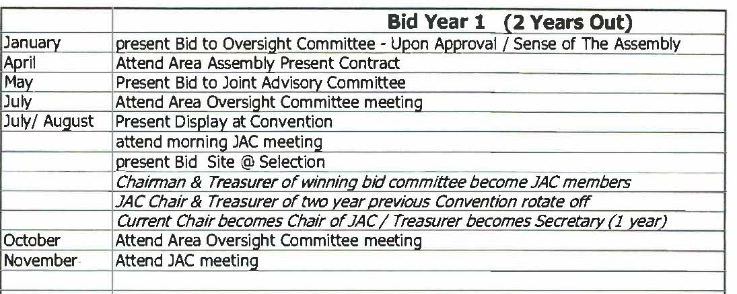
IMPORTANT is the timeline. You will need to be ready with a proposal (contract) from the Hotel by the January Assembly, 2 years prior to when you want to have your Convention.

Slide 6


Slide 7
You have a draft contract ready?
Now what???

Slide 8
Get Approvals!
The next set of approvals are to make sure that the hotel is sufficient for a state convention and to make sure of the financial feasibility of the contract.

Slide 9
Area Convention Oversight Approval
    Go to Area 14 (North Florida) or Area 15 (South Florida) Florida State Convention Oversight Committee meeting at the Area Assembly by the cutoff date (January 2022) with your draft contract and bid summary sheet (2 years prior to when the convention will be held)
    Go back to Hotel to get any changes suggested by Area committee (if needed) and then go to the April Assembly Oversight meeting with all the appropriate changes.

Slide 10
Get JAC Approval
Now that the Area Committee has given your contract approval to go to JAC
Contact the JAC Chair to inform him or her that you would like to attend the JAC meeting to present your bid contract at the May JAC meeting 2 years plus prior to the actual convention you are bidding on.
JAC will go over the contract and bid summary sheet to make sure the hotel is sufficient for a state convention and it is financially feasible. Also, to be sure the contract is the best!

Slide 11
So, what’s the JAC?
As the Chief Custodian of the Florida State Convention, the JAC has a responsibility take action to avoid any negative impact on the reputation and integrity of Florida State Convention, associated Area Committees, and AA as a Whole.
Each Convention is committed to fund future conventions and the JAC maintains a prudent reserve to be sure if a convention is unable to pay their bills, they are covered by monies collected by previous conventions.

Slide 12
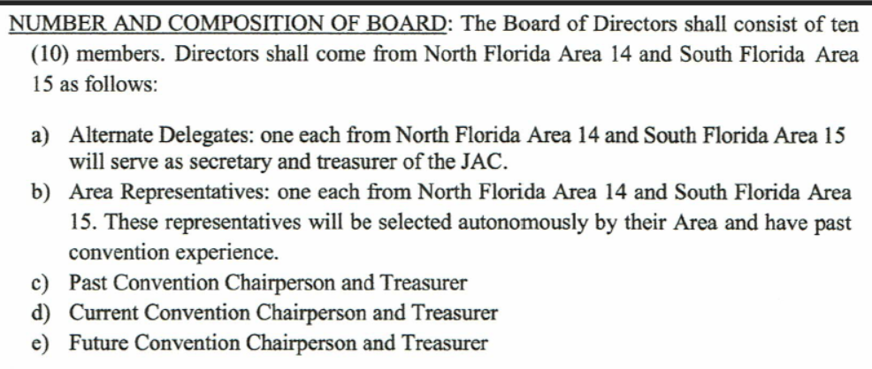
Composition of Board

Slide 13
Bid Table
Once JAC gives approval then you may set up a bid table at the State convention in July/August 2 years prior to the convention you are bidding on.
One note of caution, you are self-funded until awarded the convention.
Then at that same convention there will be a site selection meeting where the attendees vote on which hotel has won the bid.

Slide 14
YOU WIN!!!!
  Once hotel is chosen then you receive from that state convention a $5000 stipend to start off for planning etc.
  Then the fun begins…..
  You will start to get committees and planning meetings to be ready to start registering people at the next State Convention which will be 1 year prior to your convention.

Slide 15
The best part
The best part of putting on a Florida State Convention is
the two years of planning.
We get to enjoy the Fellowship all while doing service!
We do this for Fun and for Free.
So, Let’s Have Some Fun!!!

Slide 16
Questions??????

